Slide 1
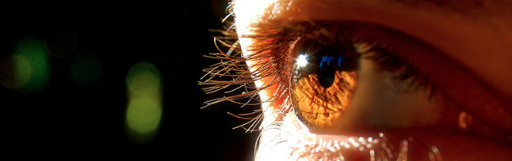
Reconocimiento de Patrones
Domingo Mery
Departmento de Ciencia de la Computación
Escuela de Ingeniería
Universidad Católica de Chile
SVM
[ Capítulo 4 ]

Slide 2
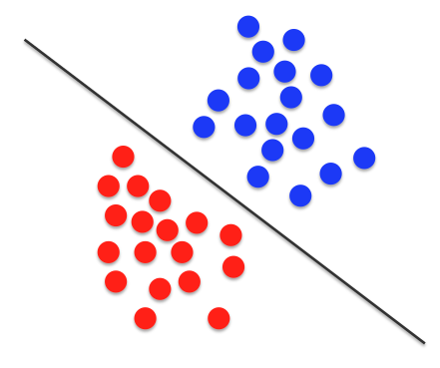
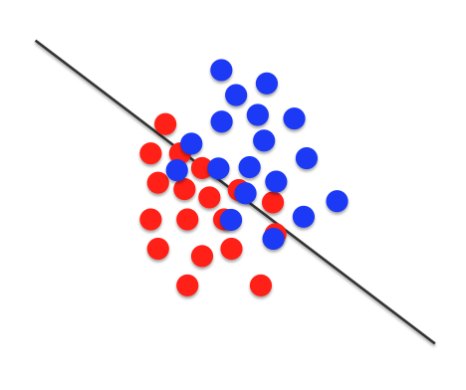
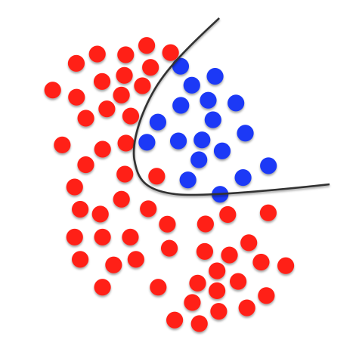
SVM: Support Vector Machines
1) Linear with perfect separation
2) Linear with no perfect separation
3) Non linear

Slide 3
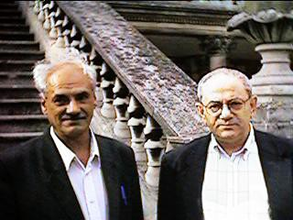
History
The Support Vector Machine algorithm was developed by two Russian mathematicians Vladimir Vapnik and Alexey Chervonenkis in 1963. Vapnik has continued developing the algorithm throughout his career, and in 1992, he created a nonlinear version of the classifier by utilizing the “kernel trick” while working with Bernhard Boser and Isabelle Guyon. He proposed the soft margin nonlinear version with Corinna Cortes in 1993, which was released in 1995.
Chervonenkis and Vapnik
https://medium.com/@nickdarby/data-chef-episode-8-svms-7fb495e96d90
https://en.wikipedia.org/wiki/Support_vector_machine#History

Slide 4
SVM: Support Vector Machines
1) Linear with perfect separation
2) Linear with no perfect separation
3) Non linear

Slide 5
SVM: Support Vector Machines (two classes)
Class 1
Training data
Class 2

Slide 6
SVM: Support Vector Machines (two classes)
Line 1 separates the classes perfectly
Line 2 separates the classes perfectly
Decision Line 1
Line 3 separates the classes perfectly
Decision Line 2
Which one is better?
Decision Line 3

Slide 7
SVM: Support Vector Machines (two classes)
For a decision line, we define margin ‘b₁’ as the perpendicular distance of the line to the nearest sample of class 1.
Decision Line
And we define margin ‘b₂’ as the perpendicular distance of the line to the nearest sample of class 2.
.
b₂
.
b₁

Slide 8
SVM: Support Vector Machines (two classes)
KEY IDEAS OF SVM:
b₁ = b₂ = b.
Decision Line
.
b₂
.
b₁

Slide 9
SVM: Support Vector Machines (two classes)
KEY IDEAS OF SVM:
b₁ = b₂ = b.
Decision Line
.
b₂= b
.
b₁ = b

Slide 10
SVM: Support Vector Machines (two classes)
KEY IDEAS OF SVM:
b₁ = b₂ = b.
Decision Line
.
.
b
b

Slide 11
SVM: Support Vector Machines (two classes)
KEY IDEAS OF SVM:
b₁ = b₂ = b.
b must be maximized.
Decision Line
.
.
b
b

Slide 12
SVM: Support Vector Machines (two classes)
KEY IDEAS OF SVM:
b₁ = b₂ = b.
b must be maximized.
Decision Line
.
.
.
b_{max}
b_{max}

Slide 13
SVM: Support Vector Machines (two classes)
KEY IDEAS OF SVM:
b₁ = b₂ = b.
b must be maximized.
Decision Line
.
.
Support Vectors
.
b_{max}
b_{max}

Slide 14
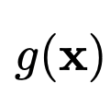
SVM: Support Vector Machines (two classes)
KEY IDEAS OF SVM:
b₁ = b₂ = b.
b must be maximized.
Solution:
Decision Line
b_{max}
b_{max}

Slide 15
SVM: Support Vector Machines (two classes)
KEY IDEAS OF SVM:
b₁ = b₂ = b.
b must be maximized.
Solution:
Decision Line
Decision Line
b_{max}
b_{max}

Slide 16
The Solution of SVM
Number of
support vectors
constants
constant
TRAINING:
decision line
Testing
sample
Training data
Optimization
features
+1 or -1
(2 classes)
Training data for
Support vectors
TESTING: then class = +1
else class = -1

Slide 17
SVM: Support Vector Machines (two classes)
Decision Line
Testing data
?

Slide 18
SVM: Support Vector Machines (two classes)
Decision Line
Testing data

Slide 19
SVM: Support Vector Machines
1) Linear with perfect separation
2) Linear with no perfect separation
3) Non linear

Slide 20
SVM: Support Vector Machines (two classes)
How to define the decision line when there is no perfect separation?

Slide 21
SVM: Support Vector Machines (two classes)
How to define the decision line when there is no perfect separation?
We consider only the miss-classified samples

Slide 22
SVM: Support Vector Machines (two classes)
How to define the decision line when there is no perfect separation?
We consider only the miss-classified samples

Slide 23
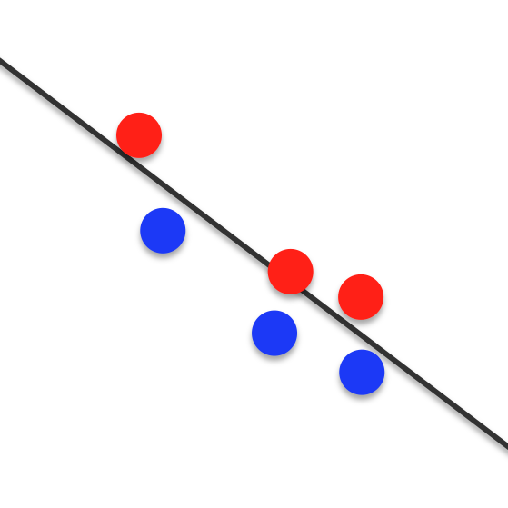
SVM: Support Vector Machines (two classes)
How to define the decision line when there is no perfect separation?
We consider only the miss-classified samples
.
.
Support Vectors
.
.
.
.

Slide 24
KEY IDEA OF SVM:
.
Find the decision line so that
e = Σ e_{i} ➔ min
e₁
.
Support Vectors
e₄
e_{i}: errors
.
e₂
.
.
e₅
e₃
.
e₆

Slide 25
SVM: Support Vector Machines
1) Linear with perfect separation
2) Linear with no perfect separation
3) Non linear

Slide 27
1
a
2
b
c
d
e
3
4
5

Slide 28
1
New coordinate system
a
2
b
c
d
e
3
4
5

Slide 29
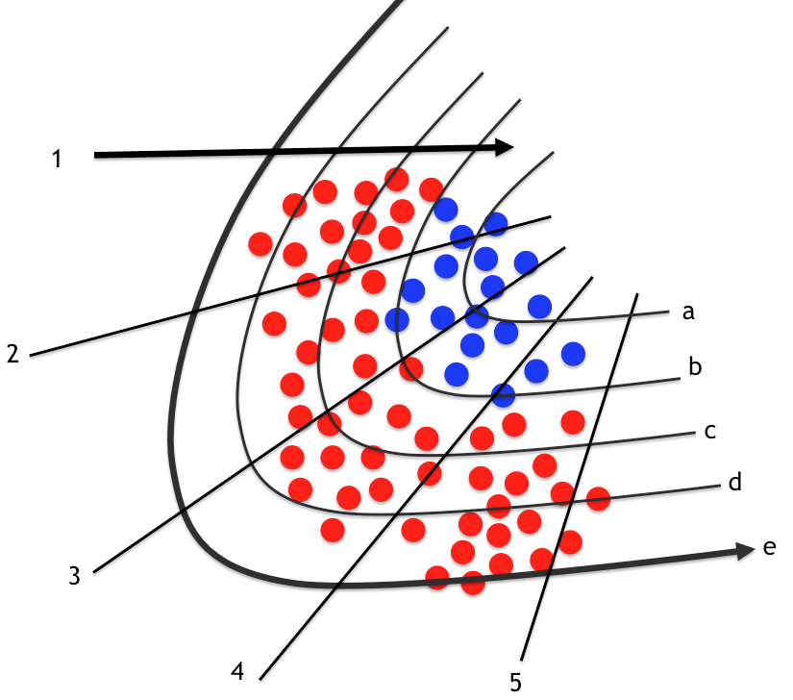
Non linear geometric transformation
a
b
c
d
e
1
2
3
4
5

Slide 31
Linear SVM in new coordinate system
Non linear geometric transformation

Slide 32
Decision line

Slide 33
SVM: Support Vector Machines (two classes)
Decision Line
b_{max}
b_{max}

Slide 34
SVM: Support Vector Machines (two classes)
Decision Line
We don’t need , we only need the kernel

Slide 35
SVM: Support Vector Machines (Kernels)
linear
polynomial
radial basis
sigmoid

Slide 36
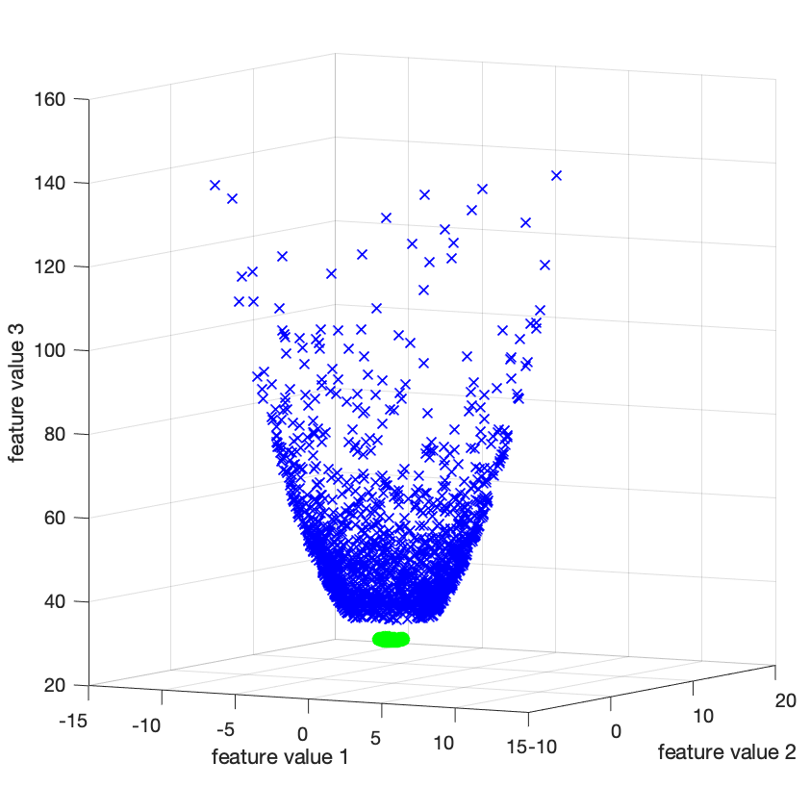
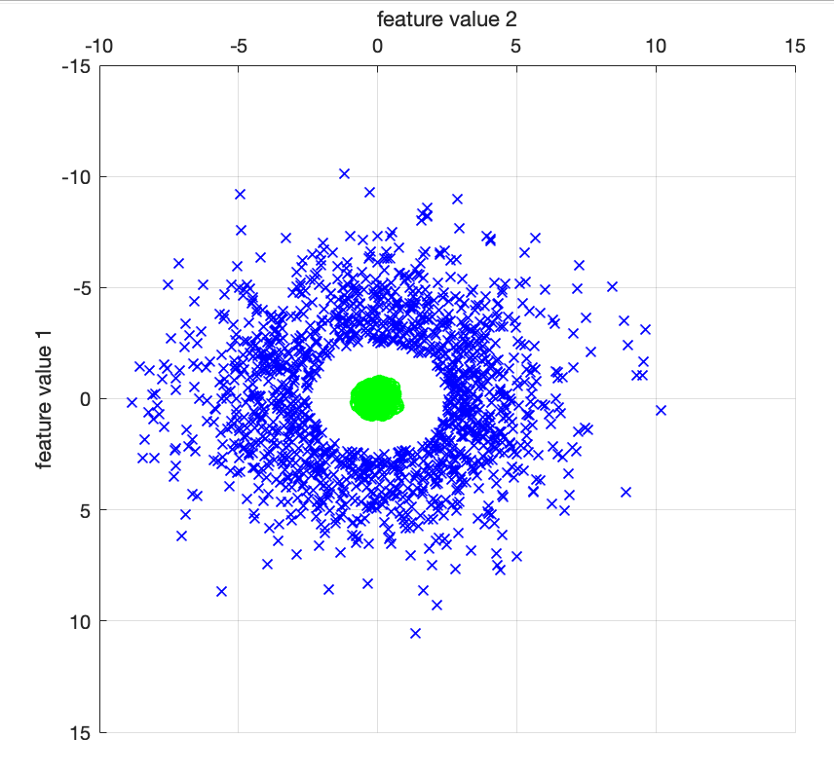
The Kernel Trick
Linear Separation is impossible
Linear Separation is Perfect
https://youtu.be/N1vOgolbjSc

Slide 37
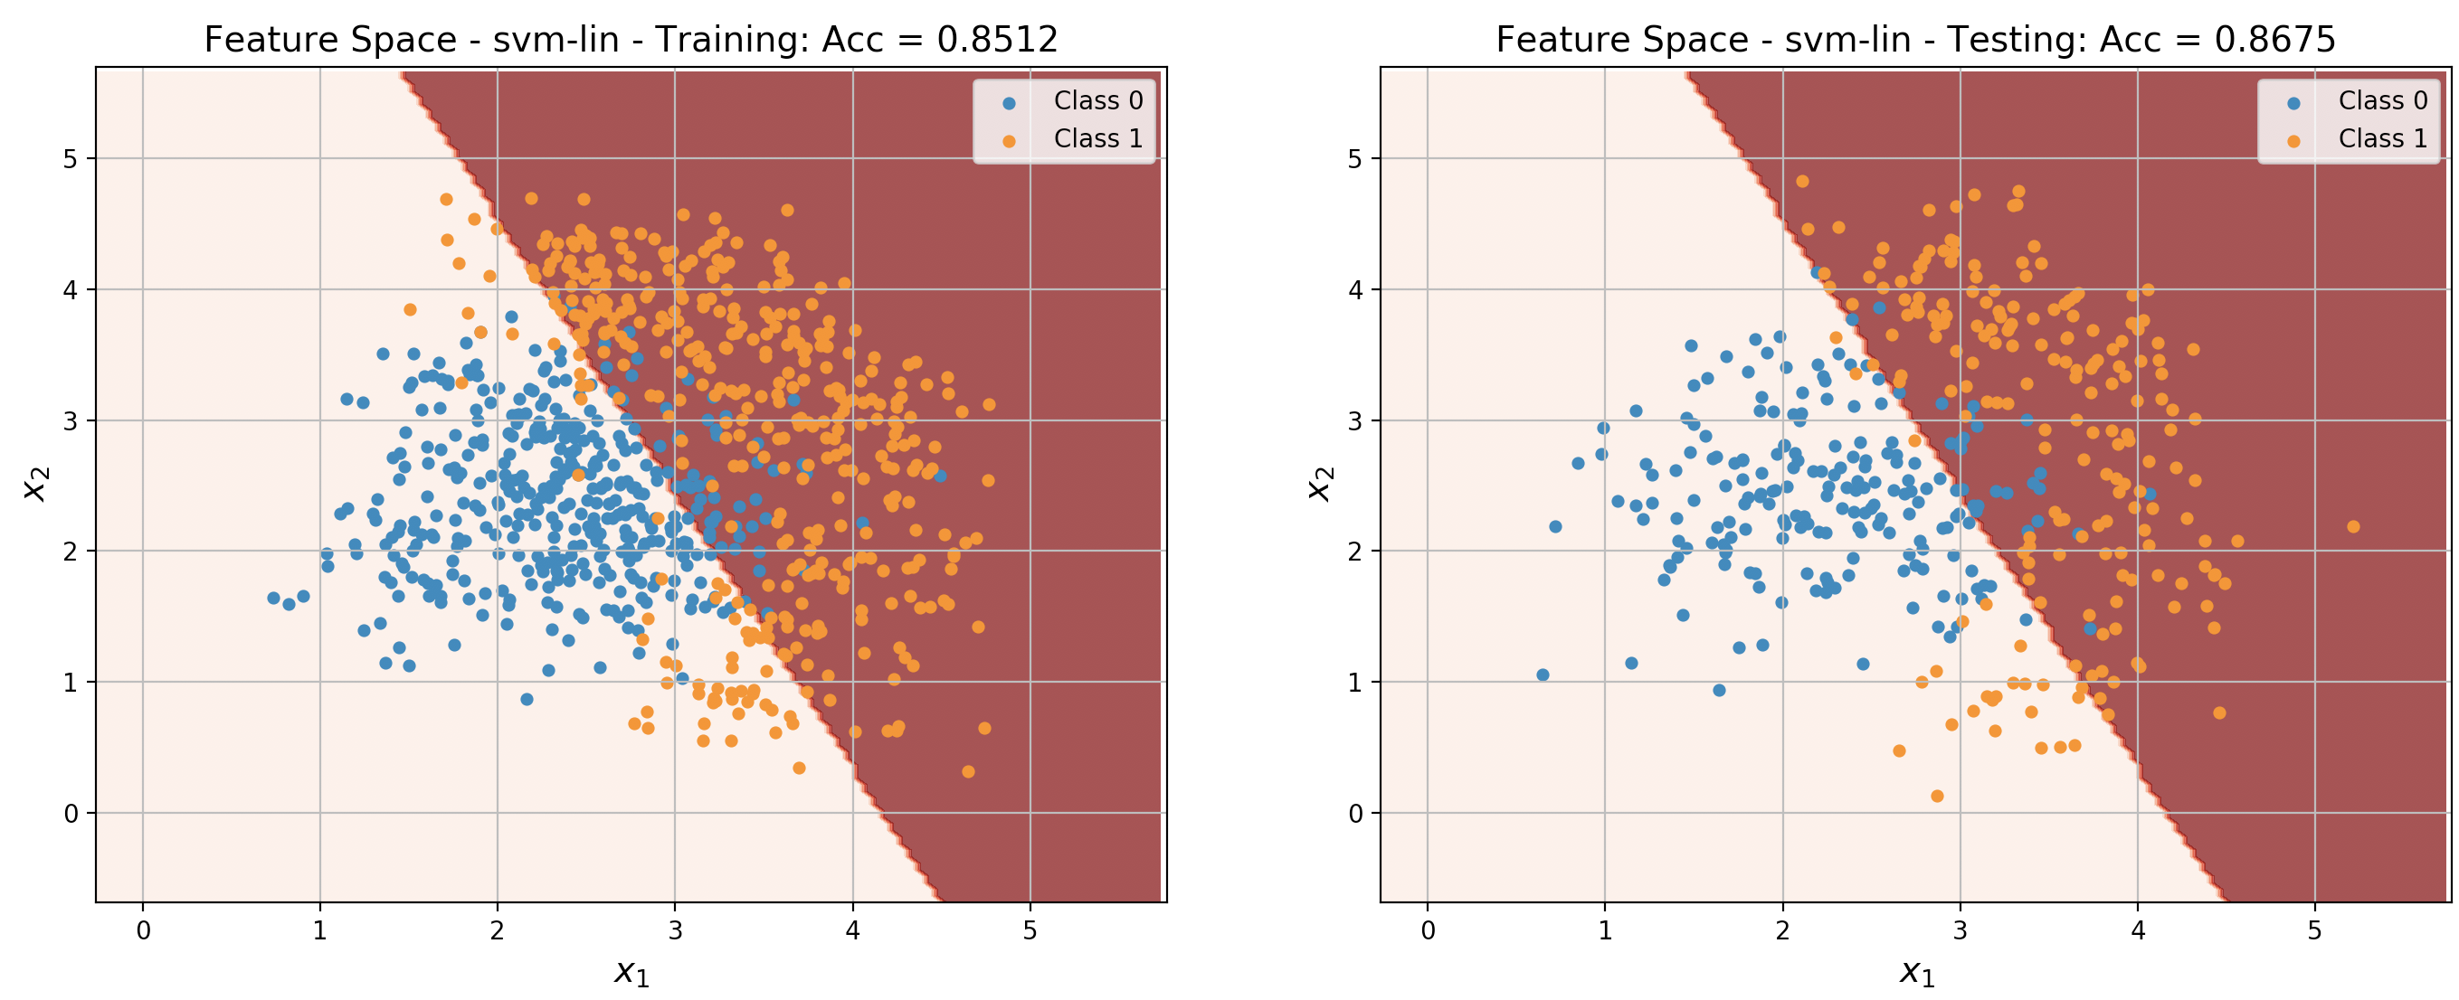
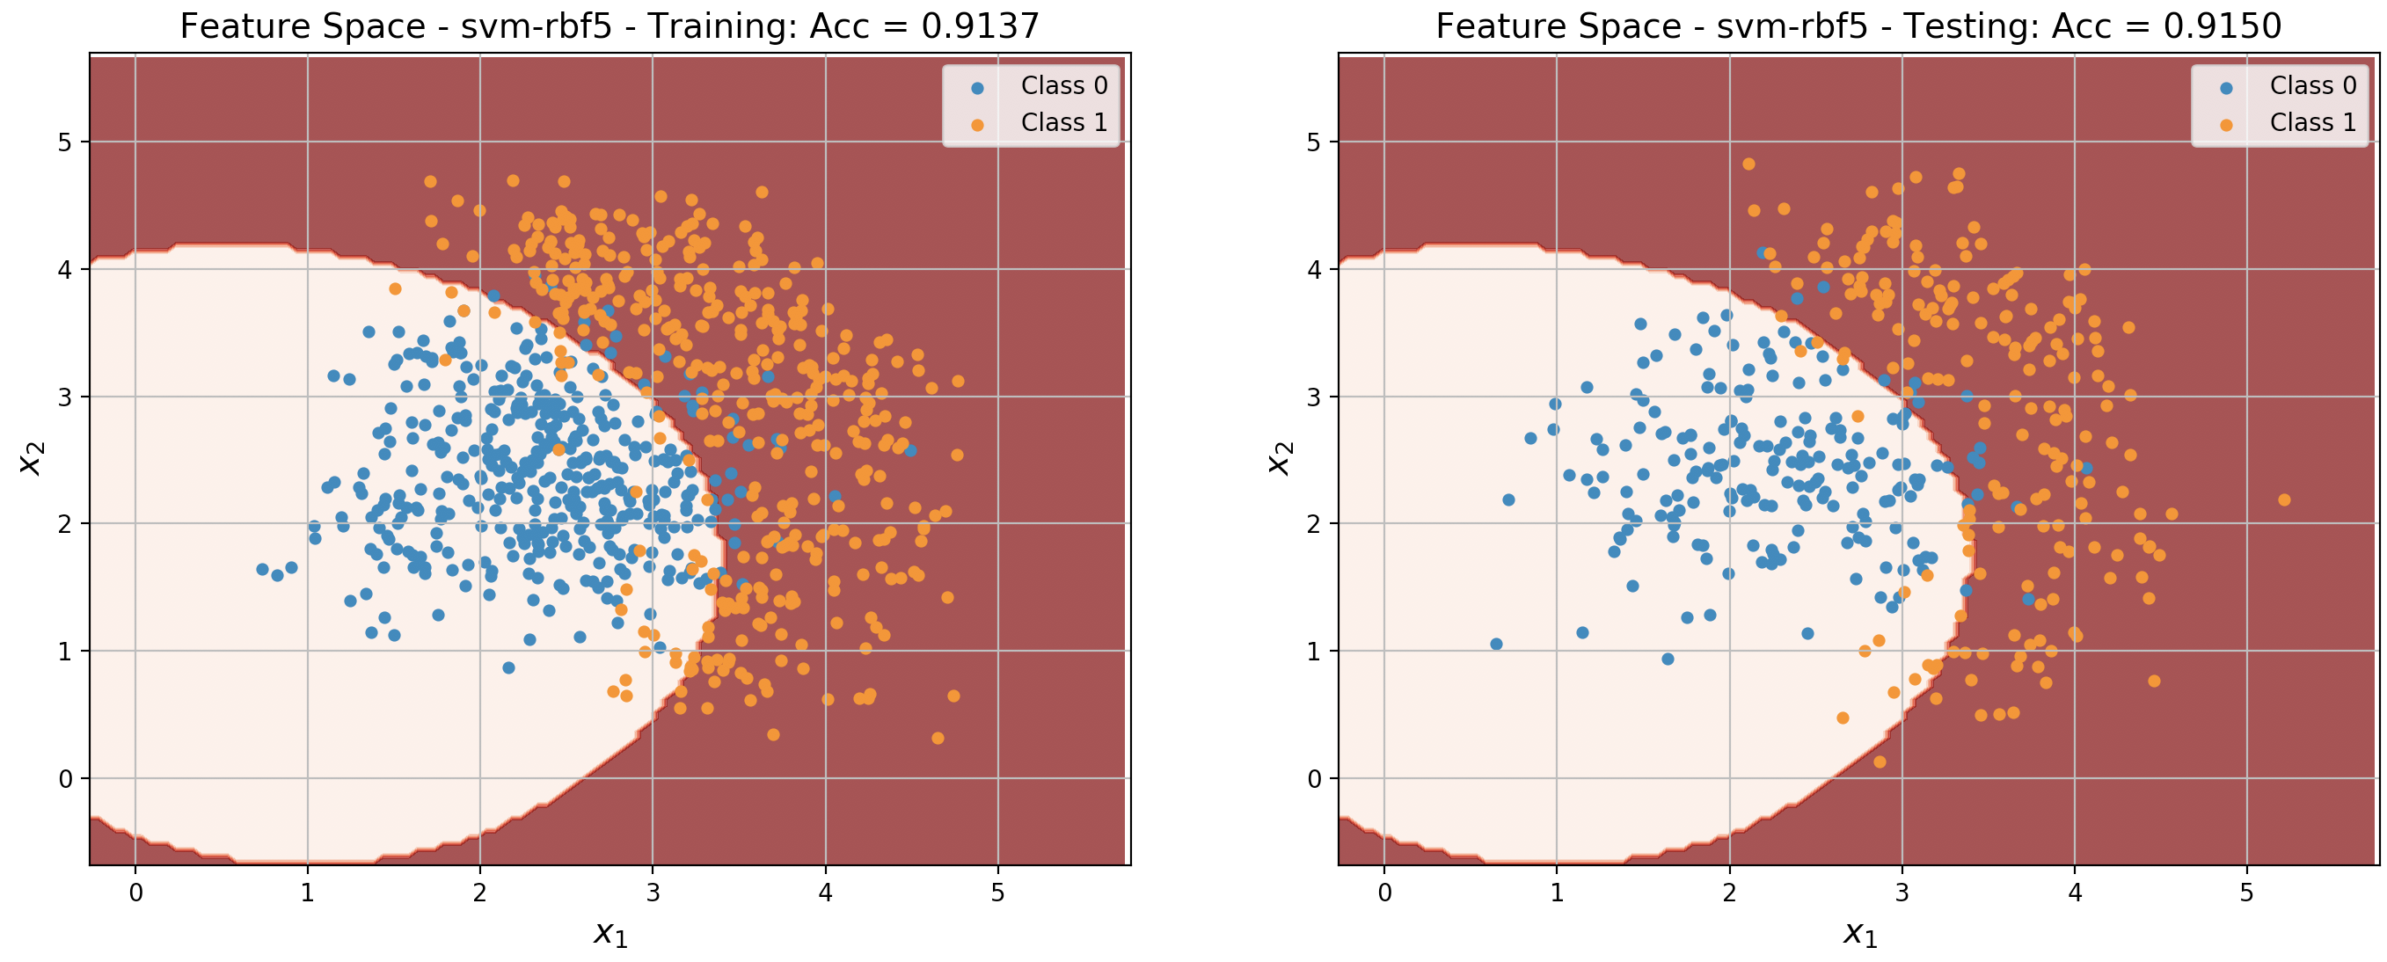
Examples: SVM-LIN and SVM-RBF

Slide 38
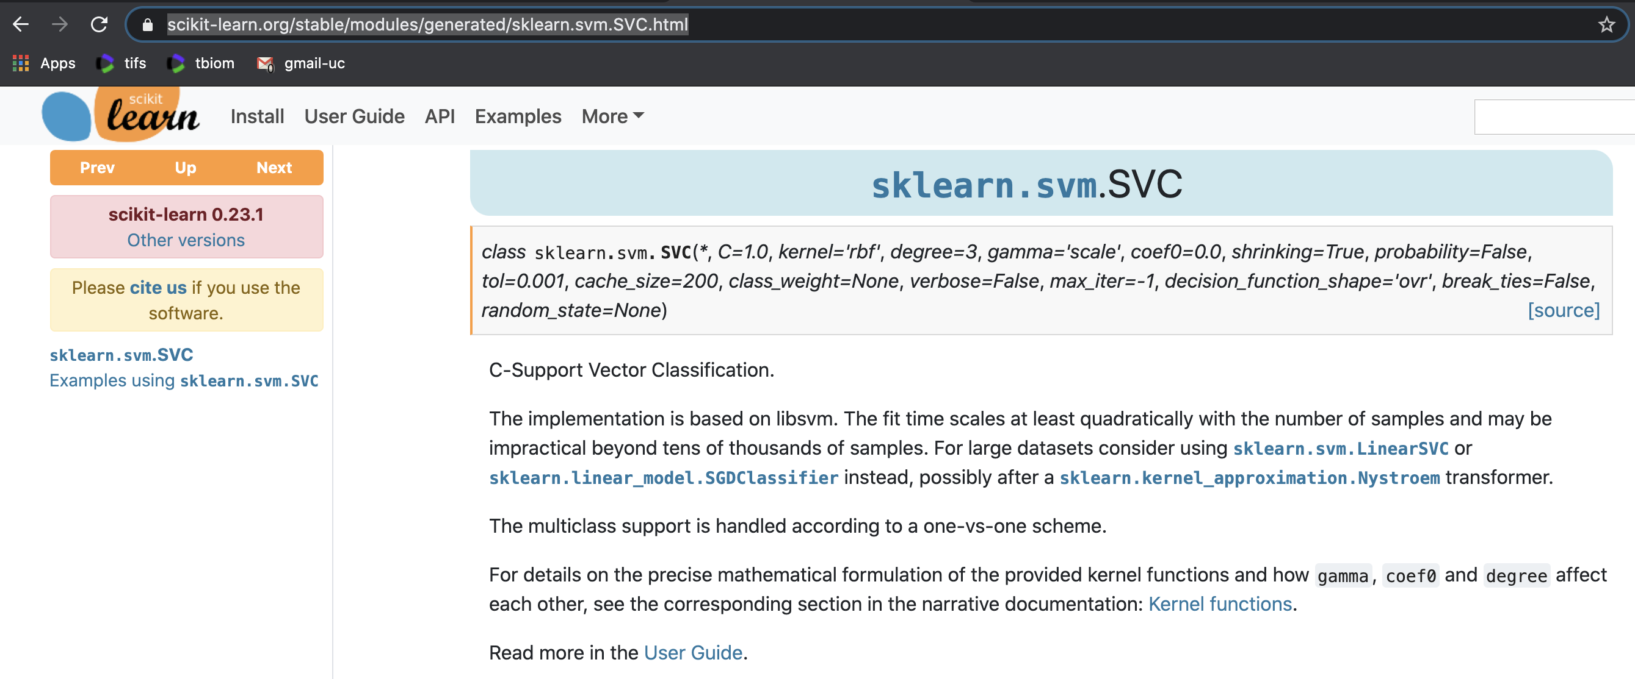
SVM in SKLEARN - Python

Slide 39
SVM in SKLEARN - Python
Intuitively, the gamma parameter defines how far the influence of a single training example reaches, with low values meaning ‘far’ and high values meaning ‘close’. The gamma parameters can be seen as the inverse of the radius of influence of samples selected by the model as support vectors.
The C parameter trades off correct classification of training examples against maximization of the decision function’s margin. For larger values of C, a smaller margin will be accepted if the decision function is better at classifying all training points correctly. A lower C will encourage a larger margin, therefore a simpler decision function, at the cost of training accuracy. In other words``C`` behaves as a regularization parameter in the SVM.
https://scikit-learn.org/stable/auto_examples/svm/plot_rbf_parameters.html

Slide 40
SVM: Support Vector Machines
1) Linear with perfect separation
2) Linear with no perfect separation
3) Non linear

